Slide 1
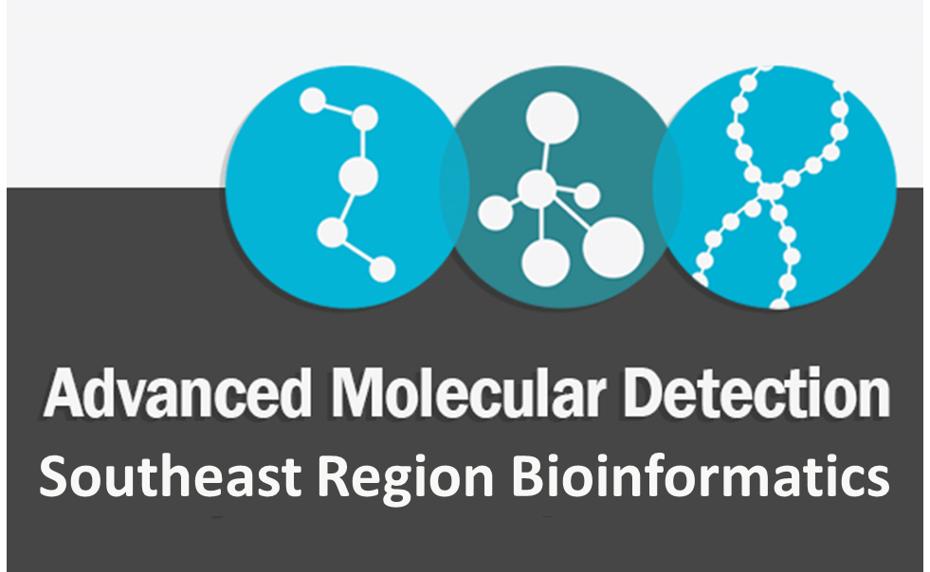
AMD Southeast Region Check-in Call
02/02/2023

Slide 2
Outline
HPG Updates & Trainings
ELC Updates
Pipeline Updates (FL & CDC)
Workforce Development & BRR Staff Introduction

Slide 3
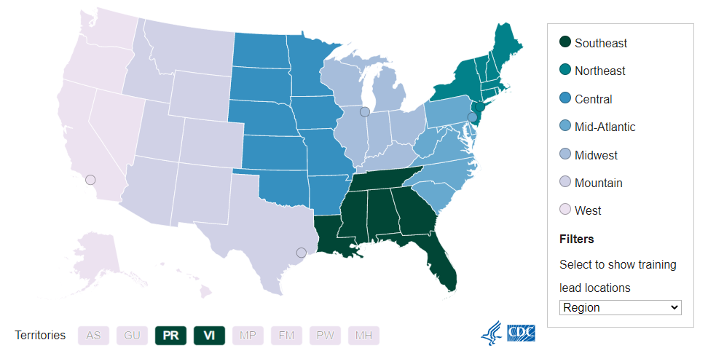

CDC AMD Regions
CDC’s Advanced Molecular Detection (AMD) program builds and integrates laboratory, bioinformatics, and epidemiology technologies across CDC and nationwide.
AMD has received funding to implement these technologies in public health programs.
In 2018, the AMD program established seven workforce development regions across the country. Each region has an AMD training lead and a bioinformatics lead.
This provides a network of customized AMD support which helps develop skills and provides training assistance to public health labs across the country.
Florida and Georgia serve as leads for the Southeast Region.

Slide 4
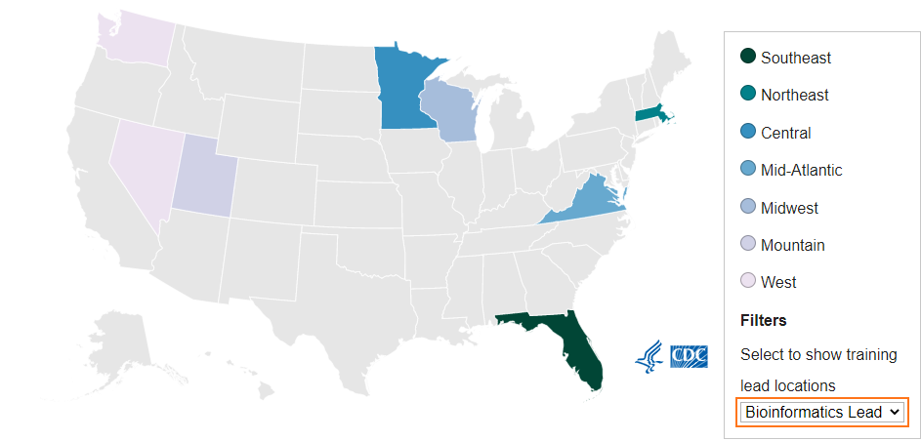
Bioinformatics Regional Resource Lead
AMD Regional Bioinformatics Regional Resource Lead acts as a regional consultant.
Provides support to labs within the region on data analysis & how to interface with IT departments within the region & across regions to help develop national bioinformatics.
Also helps in implementing or expanding the use of AMD technologies.
Florida serves as BRR Lead for the Southeast Region.

Slide 5


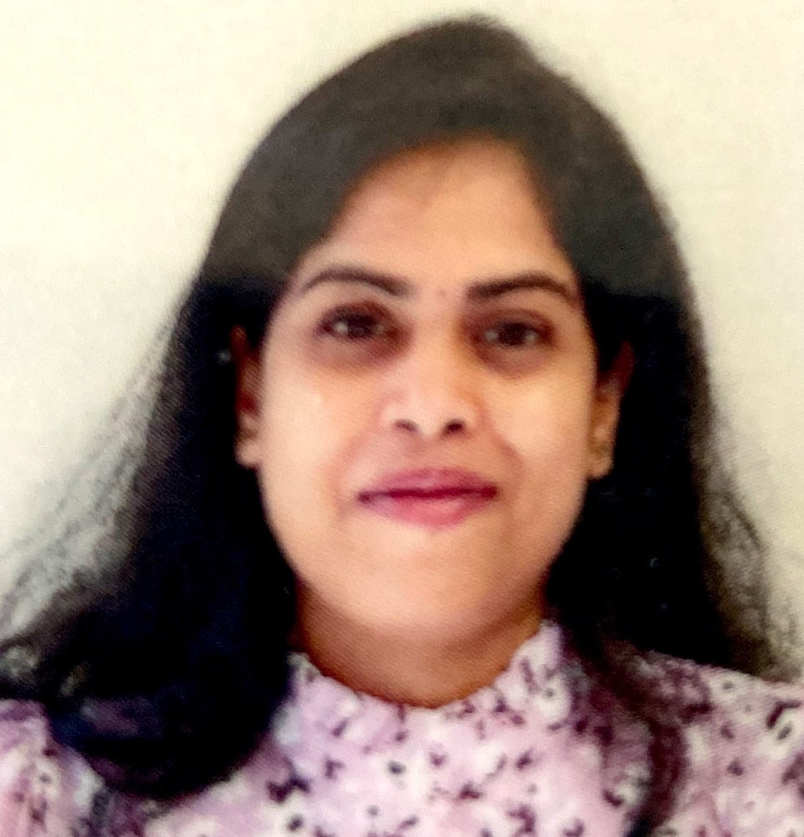
BRR Team
Sarah Schmedes, PhD
Lead Bioinformatician
Sarah.Schmedes@flhealth.gov
Molly Mitchell
Bioinformatician
Molly.Mitchell@flhealth.gov
Lakshmi Thsaliki, MS
Bioinformatician
Lakshmi.Thsaliki@flhealth.gov
For any BRR requests, please send an email to bphl16bioinformatics@flhealth.gov
Based on the requests one of us from the team will respond as soon as possible.

Slide 6
Our Expertise
Sequencers
ISeq, MiSeq, NextSeq, PacBio, ClearLabs, and MinION
NGS Workflows and Pipelines (from wet-lab to bioinformatic analyses)
Bacterial WGS and viral targeted amplicon (clinical and wastewater)
Expertise in pipeline development, high-performance computing, tool evaluation, validation, benchmarking, testing, β-testing, phylogenetic evaluations, data visualizations, genomic epidemiology, and Ad-hoc analysis

Slide 7
Our Services
Consultations
Public Health Bioinformatics
Bioinformatics Concepts
Data management
Data analysis strategy and implementation
Data Analysis & Pipeline Development
WGS, targeted amplicon, metagenomics
Linux & command-line
Containerization
Coding, bash scripting, R, Python, Perl, Nextflow
Training and Support
One-on-one calls
Webinars/Training calls (Teams/Zoom)
Site visits

Slide 8
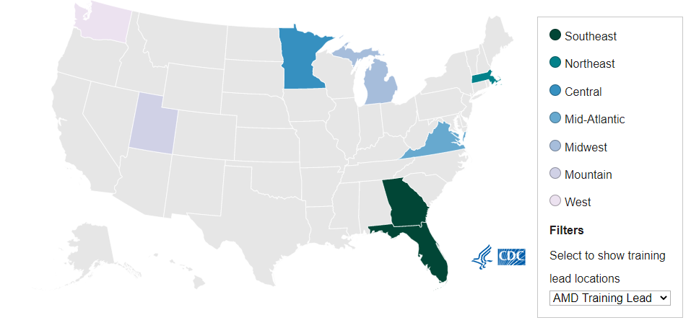
AMD Training Lead
AMD Regional Workforce Development Training Leads provide support to labs within the region and across regions on cross cutting AMD training to help staff develop the critical skills necessary to extract , analyze, and interpret sequencing data.
Regional training may incorporate local or regional resources or collaboration with academic institutions.
Georgia & Florida are the training leads for the Southeast Region.

Slide 9
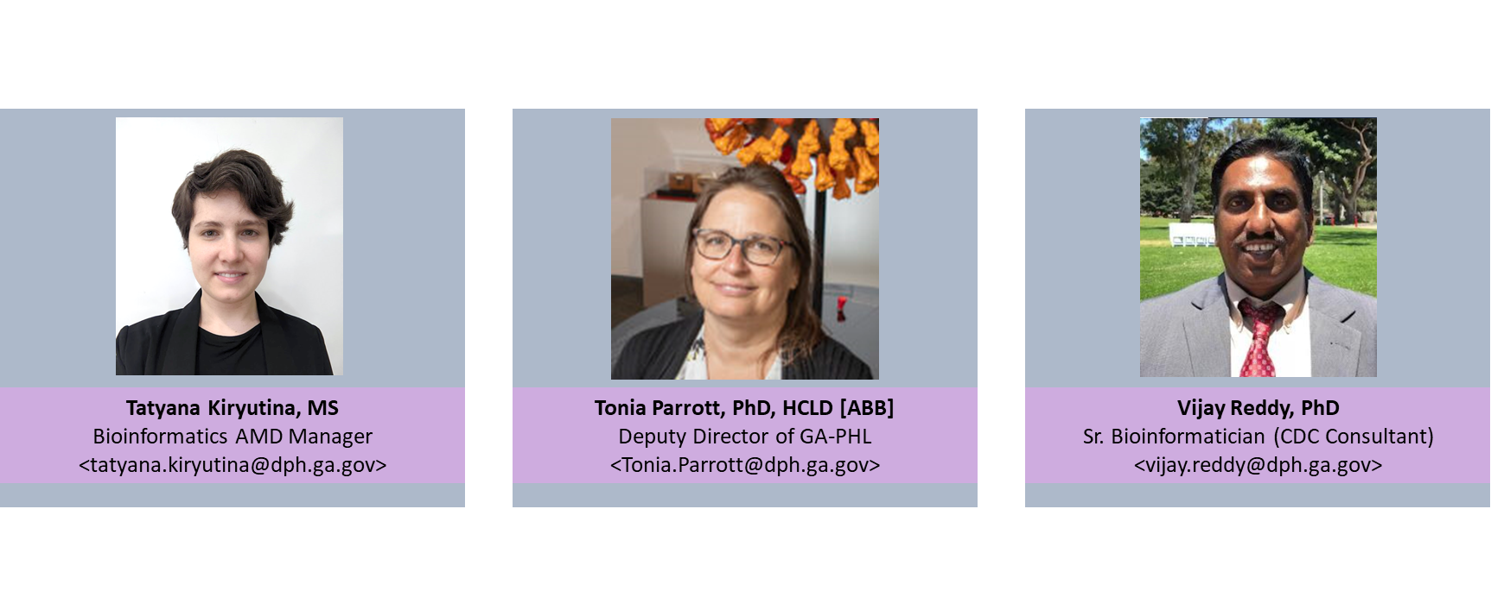
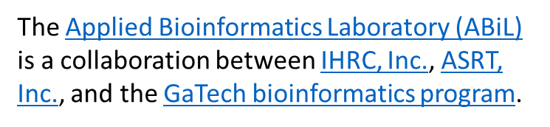
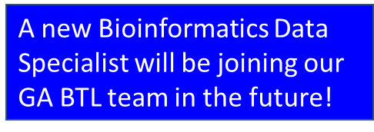

Georgia AMD BTL Team

Slide 10
What is HiPerGator?
HiPerGator is a powerful supercomputer unveiled by University of Florida which includes the latest generation of processors and offers nodes for memory-intensive computation.
HiPerGator can be accessed through Linux command line via ssh, or through galaxy.
Work on HiPerGator is submitted to SLURM scheduler to run in the batch system when resources are available.
Compute capacity is sold in NCUs which is 1 CPU core & 7.8GB RAM
Storage: Blue for high performance file system and orange for low performance file system; can be purchased in terabyte quantities.
Southeast Region jurisdictions receive computational resources for FREE (supported by BRR funding from CDC ELC)!

Slide 11
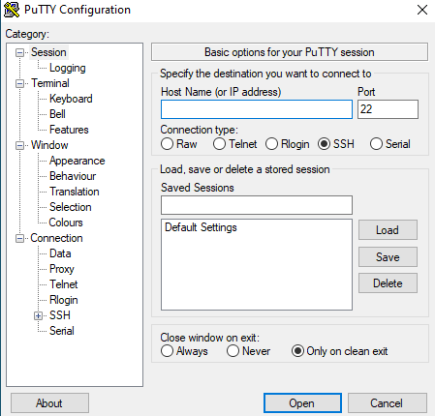
Access to HPG
Every person should have their own HPG account to perform data analysis.
Detailed instructions on how to request & access your HiPerGator account is available in the attached link (HiPerGator Account Access PDF)
There are various software programs to access HPG through your Windows computer which may need to be installed by your IT department to access HPG.

Slide 12
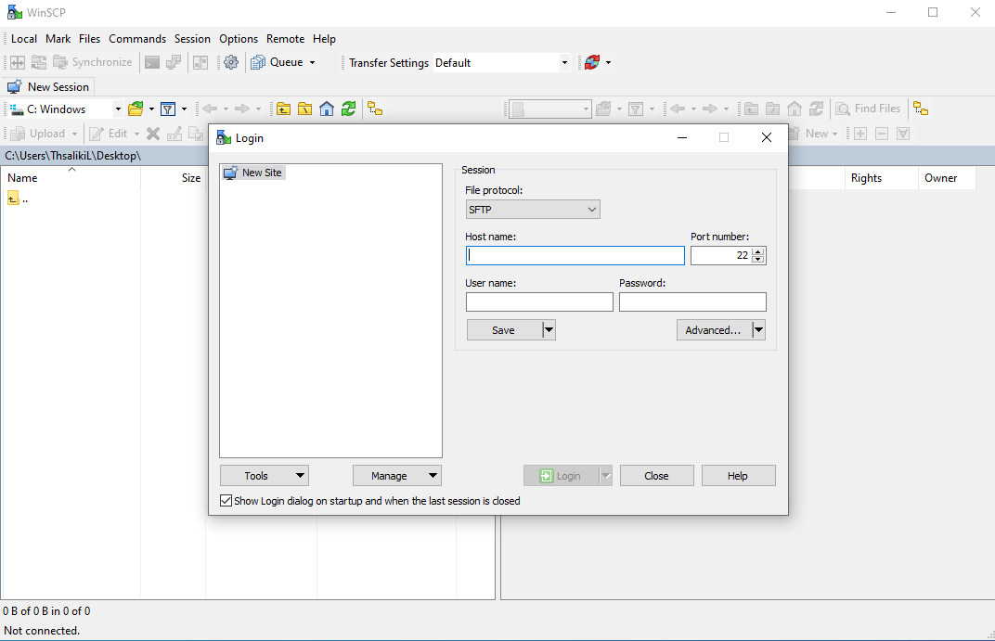
Access to HPG
Putty allows you to login to HPG and work in the command-line via a terminal.
WinSCP allows you to transfer files from your local Windows computer to HPG.
Putty & WinSCP are free software that are usually approved for use by most IT departments but there are other programs besides these that work the same.
You can always discuss those options with your IT department.

Slide 13
HiPerGator State Groups
BPHL - Umbrella
150 NCUs
BPHL - Florida
Sponsor
BPHL - Alabama
B/O TB storage
BPHL - Georgia
B/O TB storage
BPHL - Louisiana
B/O TB storage
BPHL - Mississippi
B/O TB storage
BPHL – Puerto Rico
B/O TB storage
BPHL - USVI
B/O TB storage
BPHL - Tennessee
B/O TB storage
1 Normalized Computing Unit
1(NCU) = 1 CPU with 8 GB RAM

Slide 14
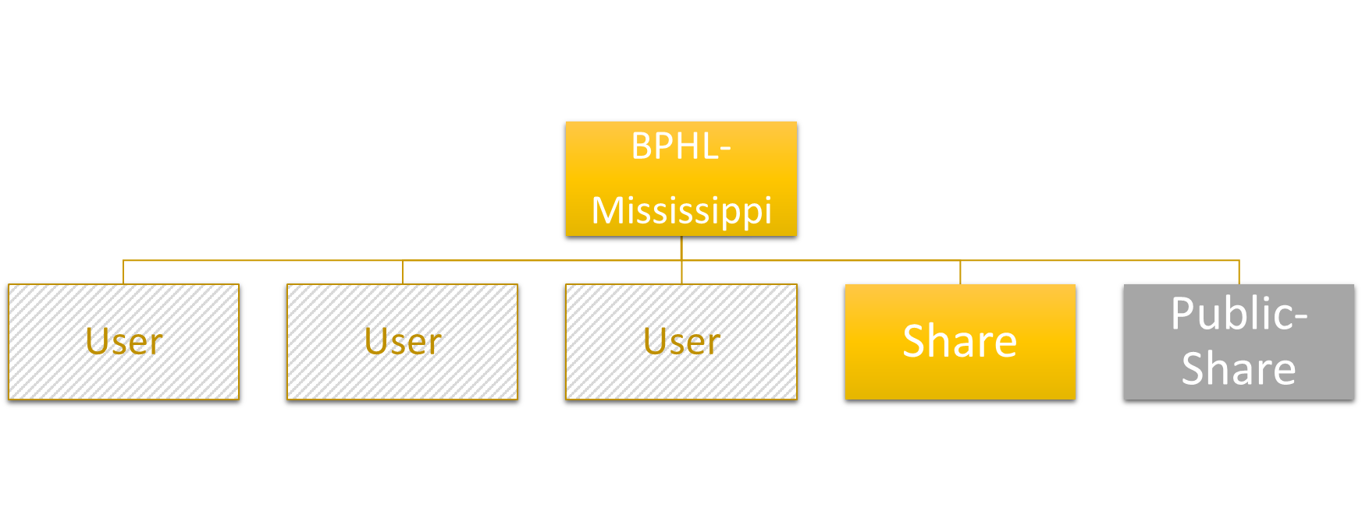



HiPerGator State Groups
Data/files private to group
Data/files private to group & BPHL-Florida
Data/files private to user

Slide 15
Storage on HPG
Home storage: /home/<user>
- 40 GB limit
- scripts, code, compiled applications
Blue storage: /blue/<group>/<user>; short-term, high-performance storage
Orange storage: /orange/<group>/; long term storage
To check your storage, you can navigate to the command line and enter
blue_quota
orange_quota
Orange and Blue storage quotas are at the group level and based on investment.
Also, if you have data that you are not actively using on HiPerGator, make sure you move the data to orange storage or to separate storage off HiPerGator.
As every lab is different, make sure your laboratory has a long-term data storage plans like cloud, server or hard drive backups that follow your lab’s data retention policies.

Slide 16
Interactive Sessions
For testing out tools in the command line that require more resources like space and time, you can use the below command
srun --qos=bphl-umbrella --account=bphl-umbrella --cpus-per-task=<number of cpus> --mem=<memAmount>gb --time=<time limit> --pty bash -i
Interactive work (other than managing jobs) should be done on a login node when the following are true:
No more than 16 cores
No longer than 10 min (wall time)
No more than 64 GB of RAM
Otherwise, you need to start an interactive session, as described above, which will allow you to work interactively on a compute node.

Slide 17
HiPerGator Trainings
Introduction to HPC & HiPerGator
Introduction to Linux – Part 1
BaseSpace Command Line Interface
Introduction to Linux – Part 2
Compute environment setup & software install
Individual pipeline trainings
Please let us know how we could improve these trainings.
Updated trainings will be shared on the StaPH-B/Southeast-region GitHub

Slide 18
HiPerGator Updates
Please note:
Singularity is now apptainer (https://apptainer.org/)
Now when you want to load the module that was singularity, use:
module load apptainer
Now you can continue as normal

Slide 19
Pipelines
FLAQ-AMR (FLAQ – Antimicrobial Resistance)
Generates annotated, de novo assemblies and quality metrics for WGS of bacterial species.
Determines species ID, serotyping using MLST schemes from PubMLST.
Identifies AMR genes, virulence genes, and plasmids.
FL-cgSNP (Core-genome SNP analysis) - reference free method
Pan-genome analysis & generates a multiple sequence alignment
Identifies pair-wise SNPs between isolates and outputs a pairwise SNP matrix and phylogenetic tree.
HqSNP (High-Quality SNP analysis) - reference free method
Uses CDC's Lyveset pipeline to identify hqSNPs
Generates a pairwise SNP matrix and maximum-likelihood phylogenetic tree.

Slide 20
Pipelines
Targeted Amplicon Variant Calling and Consensus Sequence Generation – identify variants and generate a consensus sequence for HIV genotyping (will work for any target/amplicon – just need to provide a reference sequence).
FLAQ-SC2 (FLAQ-SARS-CoV-2)
Generates SARS-CoV-2 consensus assemblies from ARTIC targeted amplicon sequencing using Illumina (e.g., Nextera XT or DNA Prep) and non-Illumina (e.g., Tailed) library prep.
Outputs variant file and final report with quality metrics (including a PASS/FAIL quality flag based on public repository submission criteria). Automatically generates flags if indels or internal stop codons are present, indicating the need for manual review, based on NCBI’s VADR annotation tool.
Individual scripts also are available to prepare and format assemblies for batch submissions to GISAID and NCBI’s Genbank, and to remove indels/SNPs that are likely PCR or sequencing artifacts/errors prior to submission).

Slide 21
Pipelines
FLAQ-SC2-meta
SARS-CoV-2 metagenomics pipeline developed primarily for wastewater samples
Automatically runs the Freyja tool to estimate lineage populations
FLAQ-SC2-clearlabs
FL BPHL's SARS-CoV-2 Clearlabs analysis pipeline
Secondary analysis pipeline using Clearlabs data outputs to generate a report with assembly metrics, pangolin lineage, and VADR flags
FLAQ-MPX
FL BPHL's Monkeypox analysis pipeline for clinical specimens
Generates consensus assembly from tiled-amplicon data and variant calling
Custom scripts and pipelines as requested or needed.

Slide 22
Pipeline Updates - Nextflow Versions (Under Active Development)
Daytona
A Nextflow version of FLAQ-SC2 and FLAQ-SC2 Clearlabs
Sanibel
A Nextflow version of the FLAQ-AMR pipeline including additional subtyping & serotyping tools specific for the species

Slide 23
Pipeline Updates - Nextflow Versions (Under Active Development)
Talbot
A Nextflow version of our FL-cgSNP pipeline
Enterovirus_assembler
A Nextflow pipeline for de novo assembly of Enterovirus, Rhinovirus, Parechoviruses using fastq data
fasta pipeline outputs can be used as input to CDC's PiType tool (Picornavirus Typing Tool (cdc.gov))

Slide 24
Analysis Request and/or support
Email bphl16bioinformatics@flhealth.gov
One-on-one Teams sessions to go through each New HPG User Training, including a walk-through to set up your HPG environment and hands-on experience with each pipeline/script needed
Custom pipeline/script development as requested
All pipelines & scripts will be shared via GitHub (BPHL-Molecular · GitHub) or the public- share directory in HiPerGator via /blue/bphl-<state>/public-share/ directory
All pipelines are currently being converted to Nextflow workflows which are compatible to work on and off HiPerGator

Slide 25
Pipeline Updates from CDC
PHoeNIx pipeline (Portable Healthcare Nextgen Informatics pipeline)
This is the replacement of Quaisar-H pipeline.
A short-read pipeline for healthcare-associated and antimicrobial resistant pathogens.
PHoeNIx is a bioinformatics analysis pipeline built using Nextflow, a workflow tool to run tasks across multiple compute infrastructures in a portable manner.
It uses Docker/Singularity containers making installation trivial and results highly reproducible.
The use of PHoeNIx provides a standardized approach for identifying and characterizing healthcare-associated bacterial pathogens, specifically for public health partners.
The Nextflow DSL 2 implementation of this pipeline uses one container per process which makes it easier to maintain and update software dependencies.

Slide 26
PHoeNIx pipeline
PHoeNIx takes in Illumina paired-end reads and was designed for use with pathogens causing healthcare-associated bacterial infections. This comprehensive pipeline performs:
Quality control
Checks for contamination
Confirms taxa ID
Performs sequence typing
Assembles reads into scaffolds
Detects antibiotic resistance and hypervirulence genes
Searches for plasmid markers
Pipeline and documentation can be found at (GitHub - CDCgov/phoenix)
This pipeline is available to run on Terra, Nextflow tower, CLI, & HiPerGator and is incorporated into the StaPH-B toolkit.

Slide 27
2023 AMD Southeast Region Trainings
2023 Bioinformatics Trainings in collaboration with ABiL
Training needs assessment (TNA) survey:
~ 60 responses received and reviewed (thanks!)
ABiL is working on quotes to include in the current contract. We will begin discussing concrete curriculums, taking your survey responses into account.
Target training deliverables (with tentative dates)
Access to modules from the existing ABiL Training services.
Intro to NGS and Bioinformatics: develop new online course (~May 2023).
In-person, four-day, advanced bioinformatics workshop in Atlanta, GA (~Fall 2023).

Slide 28
CDC AMD Platform Development Activities
The AMD platform "...integrates the latest next-generation sequencing technologies with bioinformatics and epidemiology expertise across CDC and the nation to help us find, track, and stop disease-causing pathogens faster than ever before."
AMD platform will serve CDC programs & STLT partners by providing a common infrastructure to perform genomic epidemiology and contribute high-quality data to publicly available data repositories.
The office of AMD has established five communities of practice (CoP) to build processes and tools for relevant interests, concerns, and priorities regarding the AMD platform.

Slide 29
CDC AMD Platform Development Activities
The five CoPs:
Argile Architecture, Pipeline Development, and Automation
Data Modernization
IT Security and Privacy
Genomic Epidemiology
Quality and Standards
Florida’s Domain Leader facilitates collaboration between OAMD and the public health community for the Quality and Standards CoP.

Slide 30
ELC Funding & Updates
(Program Strategy for BP4)
Program A: Cross-Cutting Epidemiology and Laboratory Capacity
Strategy 1: Enhance Workforce Capacity
1f) AMD Regional Workforce Development Training Participant
Please apply to receive funding to send participants to the in-person workshop in August/September 2023.
Strategy 6: AMD Platform Support
6a) Core Activities – Collaborate with OAMD to assess the landscape of genomic epidemiology in public health and provide subject matter expertise for AMD Platform planning (64 awards)

Slide 31
BRR Trainings and Updates
There will be an in-depth training on PHoeNIx - watch for this email
Quarterly meeting with each lab will be reinstated
Implementing a bimonthly office hours call with Molly and Lakshmi
Hour long call for questions, quick demos, and other issues
Look for this email this month

Slide 32
Links
StaPH-B GitHub link (StaPH-B Github)
StaPH-B Southeast Region GitHub link (StaPH-B Southeast Region)
StaPH-B YouTube (StaPH-B – YouTube)
BPHL-Molecular GitHub link (BPHL-Molecular · GitHub)

Slide 33
Questions?
bphl16bioinformatics@flhealth.gov
Sarah Schmedes, PhD
Lead Bioinformatician
Sarah.Schmedes@flhealth.gov
Molly Mitchell
Bioinformatician
Molly.Mitchell@flhealth.gov
Lakshmi Thsaliki, MS
Bioinformatician
Lakshmi.Thsaliki@flhealth.gov

